Slide 1
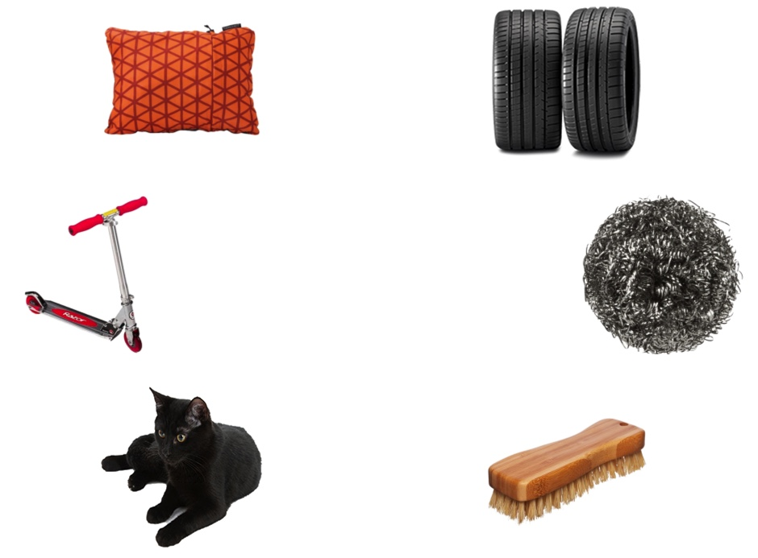
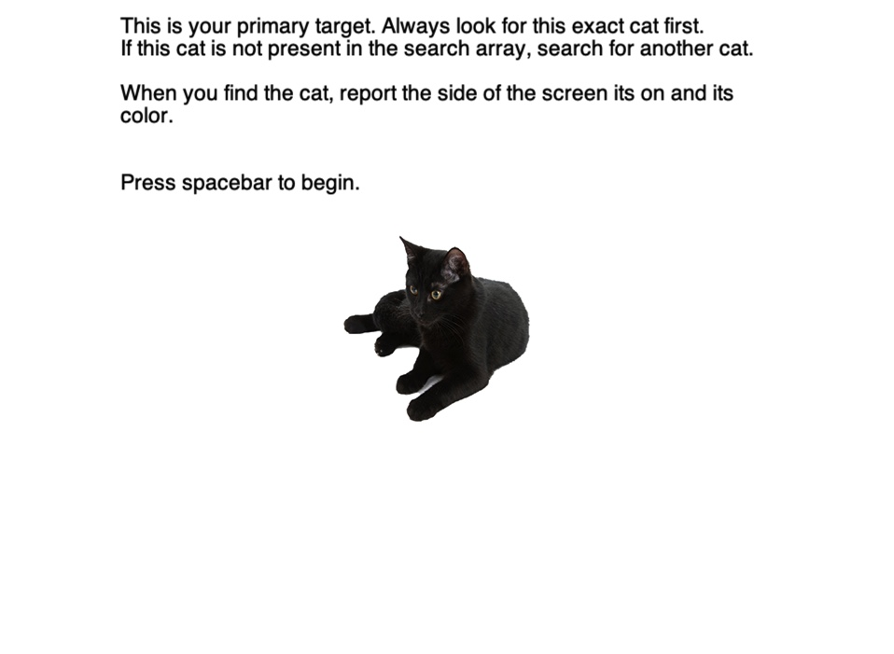
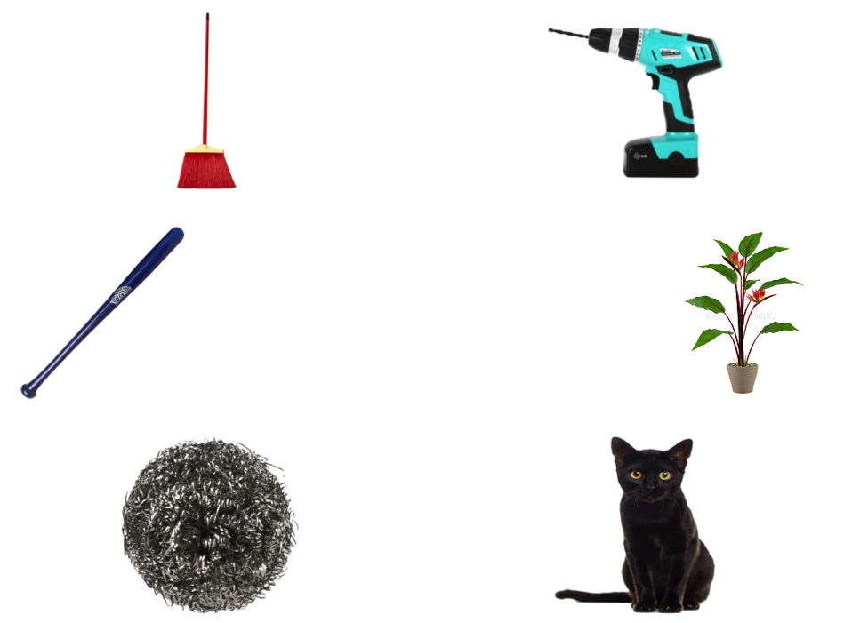

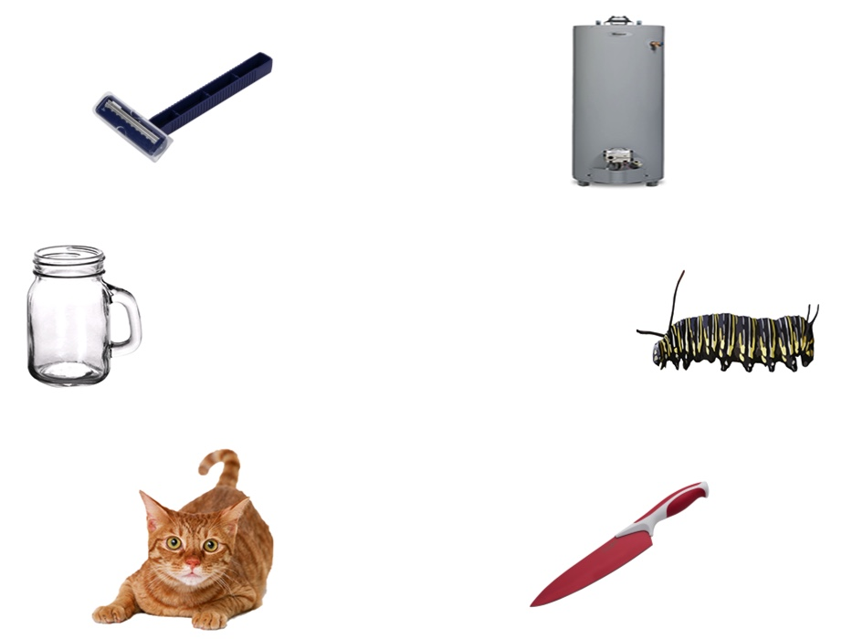
Search Array
Primary Target Condition
Learn Primary Target
Color Test
Similar Target
Condition
Other Target Condition
Until response
Until response
Until response
Notes:
Figure 1. User case for the task. Before the experiment began, participants viewed and memorized the primary target. This display stays on the screen until participants make a keyboard response. They were told to always search for this target first and, if it was not present, to search for another cat. This created three experimental conditions: primary target condition (the primary target is present in the search array), similar target condition (a cat that is the same color as the primary target is present in the search array), and other target condition (a cat that is a different color than the primary target is present in the search array). Participants responded to the side of the screen that the target was on using a keypress. This display stays on the screen until participants make a keyboard response. Following the search array, a color test would appear. Participants clicked on the box that represented the color of the cat from that trial using the mouse. This display stays on the screen until participants make a mouse click response. Participants completed 10 practice trials of the search array and color test, followed by 180 experimental trials. The primary target remained the same throughout the experiment.

Slide 2
Search Array
Primary Target Condition
Color Test
Similar Target
Condition
Other Target Condition
Until response
Until response
Notes:
Figure 2. User case for a major function (RunTask()). The purpose of this function is to run 180 experimental trials of the search array and color task and to write the output to the log_file (CatData.csv). The function takes no input arguments but receives the participant’s responses and outputs those responses and the search array data to the log_file (CatData.csv).
Primary Target Condition. Sample input: Press “j” during the search array. Click on the black box during the color test. Sample output: “Cat_1_1.bmp” is the target image. “left” is the side of the screen the target appeared on. “j” is the key that the participant pressed. “0.7308824” is the response time from the presentation of the color task to the participant’s response. “black” is the color of the box that the participant clicked. Output in log_file (CatData.csv): “Cat_1_1.bmp left j 0.7308824 black”.
Similar Target Condition. Sample input: Press “k” during the search array. Click on the black box during the color test. Sample output: “Cat_1_2.bmp” is the target image. “right” is the side of the screen the target appeared on. “k” is the key that the participant pressed. “0.8824730” is the response time from the presentation of the color task to the participant’s response. “black” is the color of the box that the participant clicked. Output in log_file (CatData.csv): “Cat_1_2.bmp right k 0.8824730 black”.
Other Target Condition. Sample input: Press “j” during the search array. Click on the black box during the color test. Sample output: “Cat_2_2.bmp” is the target image. “left” is the side of the screen the target appeared on. “j” is the key that the participant pressed. “0.8420874” is the response time from the presentation of the color task to the participant’s response. “orange” is the color of the box that the participant clicked. Output in log_file (CatData.csv): “Cat_2_2.bmp left j 0.8420874 orange”.

